Slide 1
Angular4 Introduction

Slide 2

Course Objective
To understand and develop rich interactive Web Application using Angular4.

Slide 3
Introduction
Angular is a platform and framework for building client applications in HTML and TypeScript.
Angular is itself written in TypeScript.
It implements core and optional functionality as a set of TypeScript libraries that you import into your apps.

Slide 4
Angular Is …
A JavaScript framework.
For building client – side applications
Using HTML, CSS and other programming languages such as JavaScript.

Slide 5
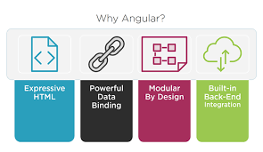
Why Angular ?

Slide 6
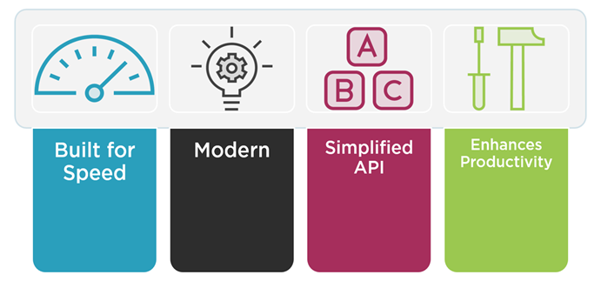
Why a new Angular?

Slide 7
Anatomy of an Angular Application
Application
Component
Component
Component
Services
Application comprised of set of components.
Services provides functionality across those components.

Slide 8
Component
Class
Component
Template
Properties
Metadata
Methods
Component comprised of template.
Template defines view for the application.
The code associated with the view defines the class contains properties and methods such as responding to button click.
Metadata provides the additional information about the component.
Notes:
Component is an view defines the template with associated code defines with class an additional information defines with metadata.

Slide 9
Angular Modules
Root
Angular Module
Angular modules defines the organizer of an application.
Every angular application has root angular module.
An application can have any number of additional angular modules
Component
Component
Component
Component

Slide 10
Modules
Every Angular app has a root module, conventionally named AppModule, which provides the bootstrap mechanism that launches the application.
An app typically contains many functional modules.
Like JavaScript modules, NgModules can import functionality from other NgModules, and allow their own functionality to be exported and used by other NgModules.
For example, to use the router service in your app, you import the Router NgModule.

Slide 11
NgModules
The basic building blocks of an Angular application are NgModules, which provide a compilation context for components.
NgModules collect related code into functional sets; an Angular app is defined by a set of NgModules.
An app always has at least a root module that enables bootstrapping, and typically has many more feature modules.

Slide 12
Component
Components define views, which are sets of screen elements that Angular can choose among and modify according to your program logic and data.
Every app has at least a root component.
Components use services, which provide specific functionality not directly related to views.
Service providers can be injected into components as dependencies, making your code modular, reusable, and efficient.

Slide 13
Component
Every Angular application has at least one component, the root component that connects a component hierarchy with the page DOM.
Each component defines a class that contains application data and logic, and is associated with an HTML template that defines a view to be displayed in a target environment.
The @Component decorator identifies the class immediately below it as a component, and provides the template and related component-specific metadata.

Slide 14
Benefits of Component-based Architecture
As you can see, this component-based architecture makes our applications more organized and maintainable. Plus, we can potentially reuse these components in various parts of an application or in an entirely different application

Slide 15
First Angular 4 Application Cont…
Install the latest version of Node.
Node comes with a tool called Node Package Manager or NPM
NPM is used to install Angular CLI.
Run the following command to install Angular CLI
npm install -g @angular/cli
The -g flag stands for global. If you don’t put -g here, Angular CLI will be installed only in the current folder, and it’s not going to be accessible anywhere else.

Slide 16
npm
Node Package Manager is an command line utility that interacts with repository of open source projects.
Using npm installs libraries, packages and applications along with dependencies

Slide 17
First Angular 4 Application Cont…
To create a new Angular project use the following command:
ng new hello-world
Angular CLI can be accessed using ng.
Angular CLI will generate a new project called “hello-world” and store it in a folder with the same name

Slide 18
First Angular 4 Application Cont…
Run the following commands in the terminal:
cd hello-world
ng serve
The command npm install will install all the dependencies of the application.
The command ng serve compiles the application and hosts it using a lightweight web server.
Access the application at http://localhost:4200.

Slide 19
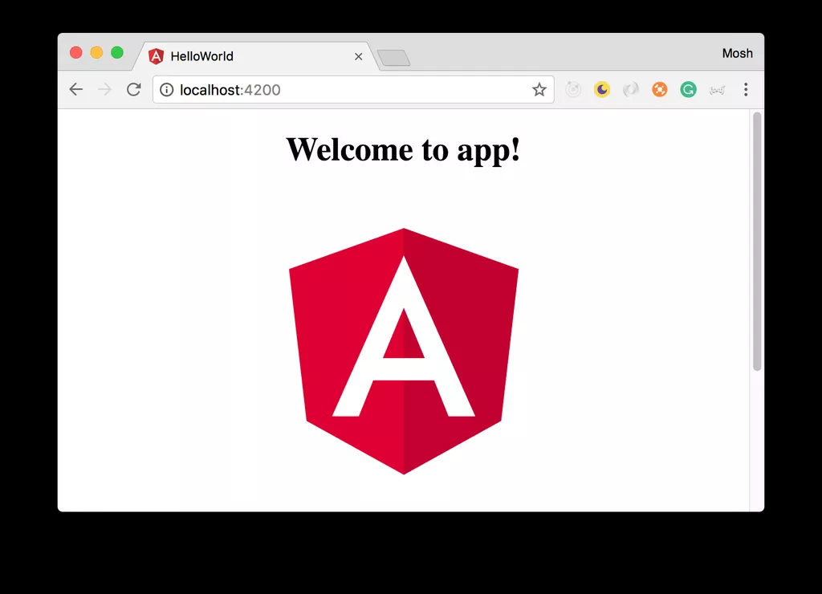
First Angular 4 Application
Open the browser and navigate to this address http://localhost:4200.

Slide 20
Structure of Angular Projects Cont…
Inside the generated folder, the following top-level folders are present:
e2e: includes end-to-end tests.
node_modules: all the third-party libraries that our project is dependent upon.
src: the actual source code of our Angular application. 9.9% of the time you’ll be working with the files inside the src folder.
angular-cli.json: a configuration file for Angular CLI. This file is used to import third-party stylesheets or define additional environments (eg testing environment) for our application.

Slide 21
Structure of Angular Projects Cont…
package.json: a standard file for Node-based projects. It contains metadata about our project, such as its name, version as well as the list of its dependencies.
protractor.conf.js: Protractor is a tool for running end-to-end tests for Angular projects.
karma.conf.js: Karma is a test runner for JavaScript applications. This file contains some configuration for Karma.

Slide 22
Structure of Angular Projects Cont…
tsconfig.json: includes setting for the TypeScript compiler.
tslint.json: includes the settings for TSLint which is a popular tool for linting TypeScript code.
It checks the quality of our TypeScript code based on a few configurable parameters.
This is especially important in a team environment to ensure that everyone follows the same conventions and produces code of the same quality.

Slide 23
Angular Component in Action
Open the src/app folder
app.component.css
app.component.html
app.component.spec.ts
app.component.ts
app.module.ts

Slide 24
Angular Component in Action
Each component in an Angular project is physically implemented using four files:
A CSS file: where we define all the styles for that component. These styles will only be scoped to this component and will not leak to the outside.
An HTML file: contains the markup to render in the DOM.

Slide 25
Angular Component in Action
A spec file: includes the unit tests.
A TypeScript file: where we define the state (the data to display) and behavior (logic) of our component.
An app.module.ts file is also present. This file defines the root module of our application and tells angular how to assemble the app.

Slide 26
Creating a Component Cont…
Generating a Component Using Angular CLI
ng g c product
g is short for generate, c is short for component and product is the name of our component.
Inside the src/app folder, a new folder product is generated. Expand this folder
product.component.css
product.component.html
product.component.spec.ts
product.component.ts

Slide 27
Creating a Component
Open product.component.ts
import { Component, OnInit } from '@angular/core';
@Component({
selector: 'app-product',
templateUrl: './product.component.html',
styleUrls: ['./product.component.css']
})
export class ProductComponent implements OnInit {
constructor() { }
ngOnInit() {
}

Slide 28
Creating a Component
we have a TypeScript class called ProductComponent.
What is a Class?
A class is a fundamental building block of many object-oriented programming languages. It’s a container for a bunch of related functions and variables.
In product.component.ts, there is a class called ProductComponent.
This class has 2 functions (methods): constructor and ngOnInit.

Slide 29
Creating a Component
Constructor is a reserved keyword in TypeScript. A method by that name is a special method in a class.
This method is called automatically when we create an instance of that class.
ngOnInit is a special method in Angular.
Angular calls this method when it creates an instance of this component and displays it to the user in the browser

Slide 30
Component Metadata
we implement a component using a TypeScript class.
But a class on its own is just a class. It only includes some data and logic for a view. It doesn’t include any HTML markup or CSS styles.
In order to attach these to this class, we need to promote this class to a component.
We can do this by using the @Component() decorator function on top of this class

Slide 31
Component Metadata
import { Component, OnInit } from '@angular/core‘;
@Component({
selector: 'app-product',
templateUrl: './product.component.html',
styleUrls: ['./product.component.css']
})
export class ProductComponent {
}

Slide 32
Component Metadata
It takes an object with the following properties:
selector
templateUrl
styleUrls
The selector associates a new HTML element to this component.
The other 2 properties templateUrl and styleUrls. They specify the path to the HTML template and CSS file(s) for this component.

